Slide 1

KACHAN (ENEMY)
By João Neto (a22200558)

Slide 2
Why is it a good enemy?
Kachan’s bullets explode at the third richochet, killing every entity in its explosion range.
Its special bullets are quite interesting for small areas, being able to represent a real threat to the player in this kind of scenario.
Kachan’s bullets give more variability to the gameplay, making the player also have to consider the bullets after-life effects.

Slide 3
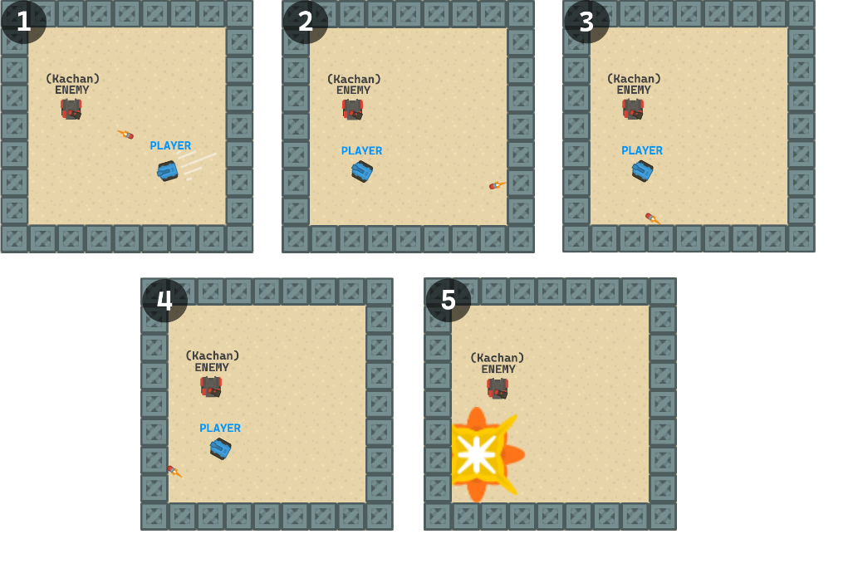
Mockup

Slide 4
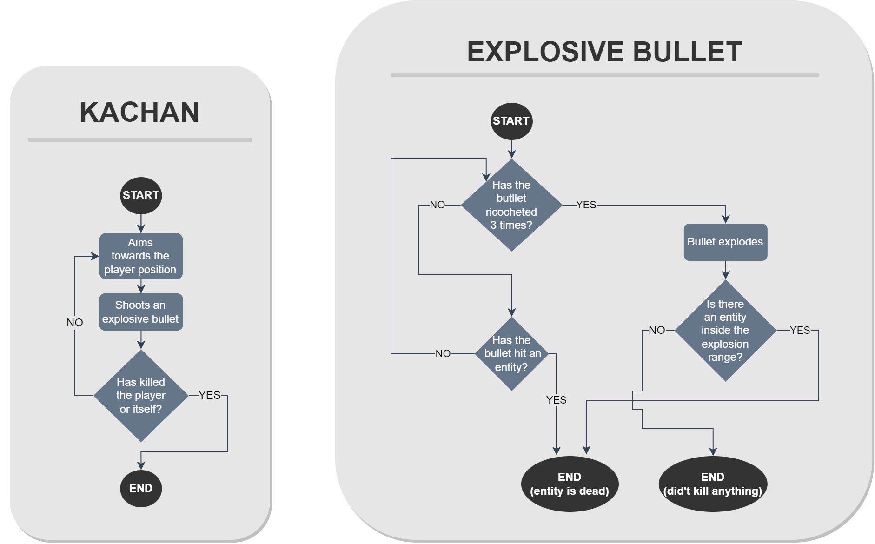
Flowchart

